Slide 1
Compiler Construction

Slide 2
Recognition of Tokens
Starting point is the language grammar to understand the tokens:
  stmt → if expr then stmt
  | if expr then stmt else stmt
  | ε
  expr → term relop term
  | term
  term → id | number
The above grammar describes a simple form of branching statements and conditional expressions.
The terminals of the grammar, which are if, then, else, relop, id, and number, are the names of tokens as far as lexical analyzer is concerned.
The patterns for these tokens are described using regular definitions.

Slide 3
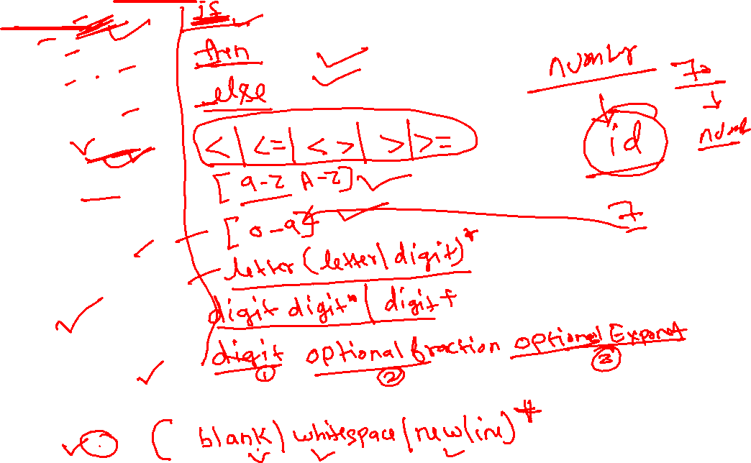
Recognition of tokens (cont.)
  if →
  then →
  else →
  relop →
  letter →
  digit →
  id →
  digits →
  number →
We also need to handle whitespaces:
  ws →

Slide 4
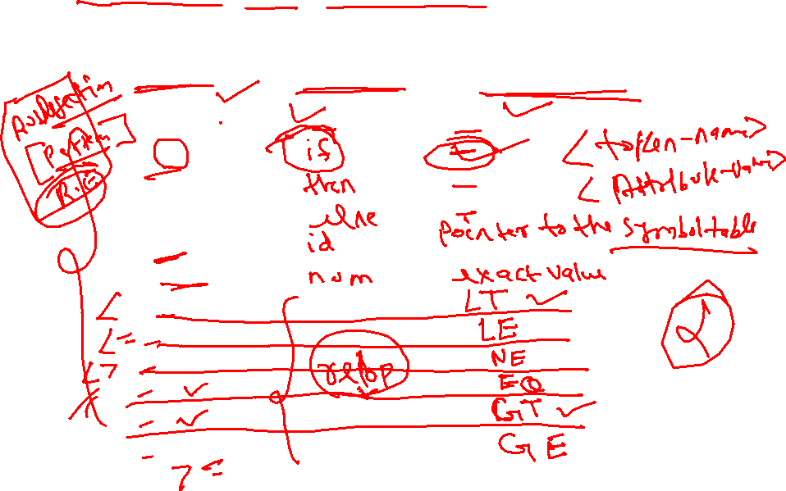
Our goal for the lexical analyzer is summarized in below table, that shows, for each lexeme or family of lexemes, which token name is returned to the parser and what attribute value is returned.
Recognition of tokens (cont.)
Lexeme
Token Name
Attribute-Value
ws
if
then
else
id
num
<
<=
< >
=
>
>=

Slide 5
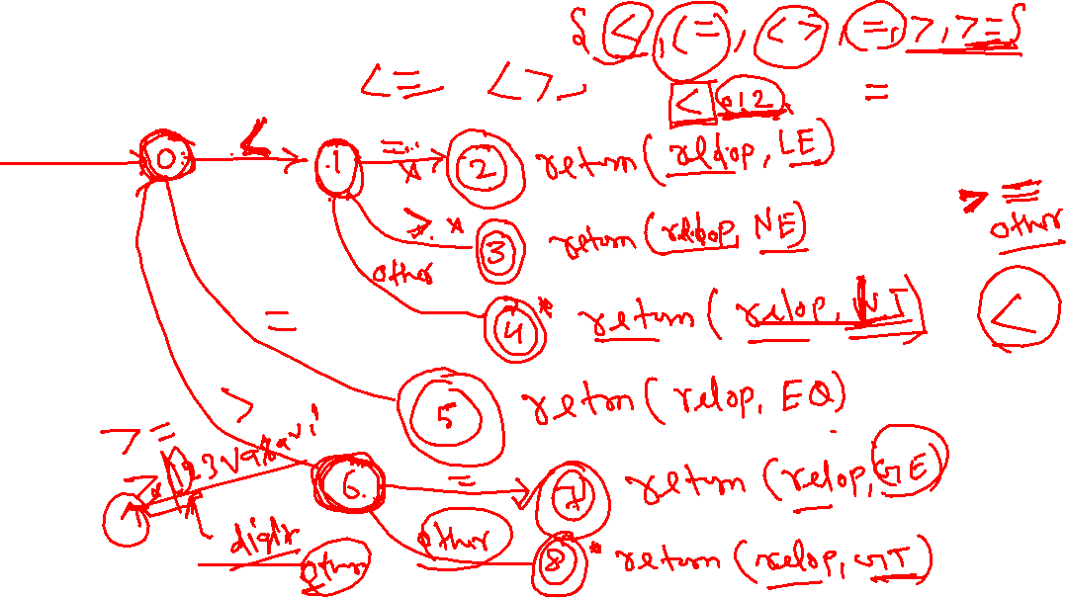

Recognition of tokens (cont.)
Transition diagram for relop
If it is necessary to retract the forward pointer one position, then we shall additionally place a * near that accepting state.

Slide 6
Recognition of tokens (cont.)
Transition diagram for reserved words and identifiers
Recognizing keywords and identifiers presents a problem.
Usually, keywords like if or then are reserved, so they are not identifiers even though they look like identifiers.
Install the reserved words in the symbol table initially.
When we find an identifier, a call to installID places it in the symbol table if it is not already there and returns a pointer to the symbol-table entry for the lexeme found.
The function getToken examines the symbol table entry for the lexeme found, and returns whatever token name the symbol table says this lexeme represents– either id or one of the keyword tokens that was initially installed in the symbol table.

Slide 7
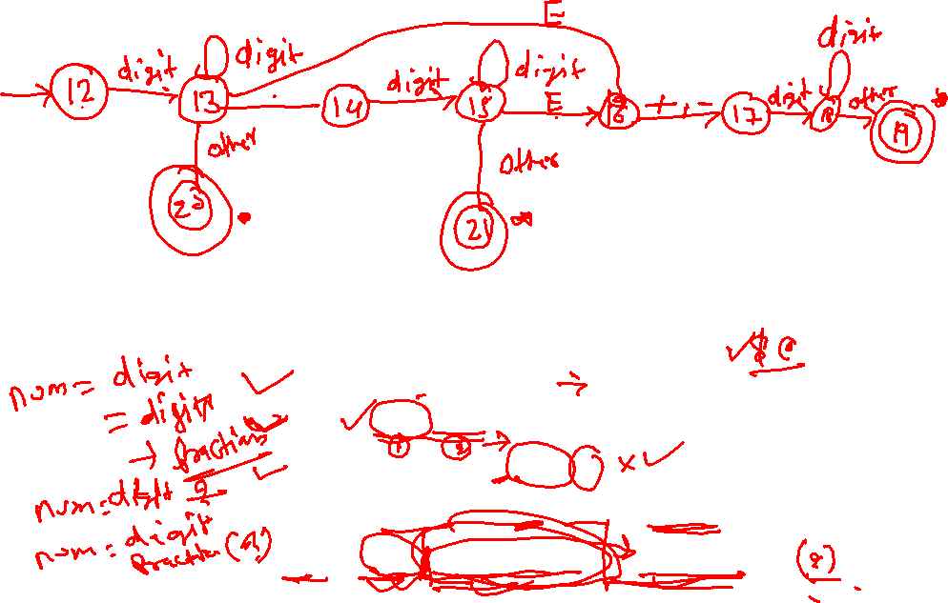
Recognition of tokens (cont.)
Transition diagram for unsigned numbers
Regular Definition:
digit → 0 | 1 | 2 | … | 9
digits → digit digit*
optional_fraction → . digits | ε
optional_exponent → ( E ( + | -| ε ) digits) | ε
num → digits optional_fraction optional_exponent

Slide 8
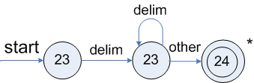
Recognition of tokens (cont.)
Transition diagram for whitespace
We look for one or more “whitespace” characters, represented by delim in the diagram – typically these characters would be blank, tab, newline, and perhaps other characters that are not considered by the language design to be part of any token.
Notes:
lec01-lexicalanalyzer

